Slide 1




OCT
25
Expression Trees in .NET
Notes:
https://docs.microsoft.com/en-us/dotnet/csharp/expression-trees-translating
Going to look at
Building
Compiling
Traversing

Slide 2

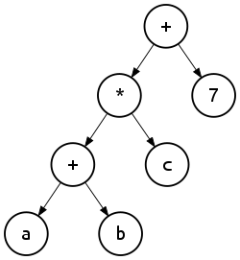
What is an Expression Tree?
Tree Data Structure representing .NET code
Collection of composite ‘Expression’ nodes
Root is of type ‘Expression’
Expressions can reference ‘child’ Expressions
You can think of all C# you write as ‘expressions’
Not all code can be represented as expression trees
e.g. async/await
Why should I care?
Dynamically create and compile executable code on the fly!
Used by IQueryable and lots of ORMs as an abstraction

Slide 3
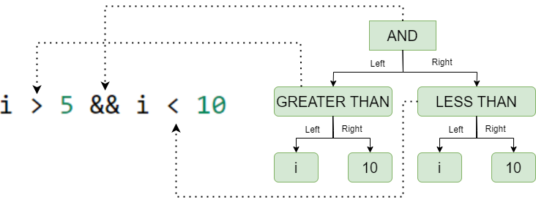
Code Visualisation
Notes:
The result of this expression could be evaluated in an if statement, assigned to a boolean variable etc.
Root Expression is “AND”
Many Expression types have a ‘Left’ and ‘Right’ property
Think of all of the nodes in this graph as actual C# objects

Slide 4

Building Expression Trees
Two methods:
Run-time (Expression API)
Compile-time (Lambda Expressions)
System.Linq.Expressions.Expression API
Static Factory Methods
E.g. Expression.Equals(...)
Compile-Time Lambda Expressions
Define a Delegate of type Expression<Delegate>
Can’t build statement lambdas
Notes:
Expression API
Less restricted in what we can define
Can create ‘headless’ expressions with no entry point if we want to
Create ‘block’ statement expressions such as a sequence of method invocations
Compile Time Lambda Expressions
Must be defined in-place
Designed for IQueryable, so has lots of limitations compared to the expression API
Null coalescing operator
Initializing new dictionaries
Can’t use multi-line (block statements)

Slide 5

Code Demo #1
Building Expression Trees

Slide 6
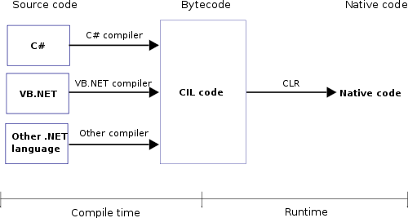
Compiling Expressions
LambdaExpression can be compiled into executable code
Returns an invocable ‘Delegate’
Only ‘LambdaExpression’ can be compiled
Expression<TDelegate> returns typed Delegate
E.g. Action<T> or Func<T>
Just like you wrote the function at compile time!
Compile() emits CIL*
Delegate parameters are referenced in the tree
Notes:
Delegate is a data structure that refers to a method invocation
Think of it as a method pointer which can have a signature
Func<T> and Action<T> are special types of delegates
Closure warnings:
Be careful of disposable things
Compilation depends on whether or not Reflection.Emit is available
Mono on iOS uses the interpreter for example: https://github.com/mono/mono/tree/effa4c07ba850bedbe1ff54b2a5df281c058ebcb/mcs/class/dlr/Runtime/Microsoft.Dynamic/Interpreter

Slide 7
Code Demo #2
Building Expression Trees

Slide 8
Parsing Expressions
Expressions are structured as a ‘Composite’ of nodes
Can use the ‘Visitor’ pattern to recurse the tree
Expression object defines an enum ‘ExpressionType’
Already an extendable ‘ExpressionVisitor’ type
Implements boilerplate of visitor pattern
Looks at expression type enum and calls explicit visitor
For each type, visits children recursively
Expressions are immutable
ExpressionVisitor returns an Expression
This can be the original Expression or a new one
Notes:
Delegate is a data structure that refers to a method invocation
Think of it as a method pointer which can have a signature
Func<T> and Action<T> are special types of delegates
Closure warnings:
Be careful of disposable things

Slide 9
Code Demo #3
Parsing Expression Trees

Slide 10
Use Cases
Improving run-time performance
E.g. Reflection
Dynamically extend functionality
E.g. Moq
Defining abstractions
E.g. Entity Framework
Be careful! (ISP, OCP)
Transpiling code

Slide 11


